Slide 1

ETL on Hadoop proof-of-concept
Connor Callison
5/2/2017

Slide 2
Project Goals
Construct a proof of concept Hadoop cluster. (3 nodes)
Test and evaluate several distributed ETL technologies.
Compare to current solution. (Oracle)
Document and review each of the tested technologies for future decision making.

Slide 3
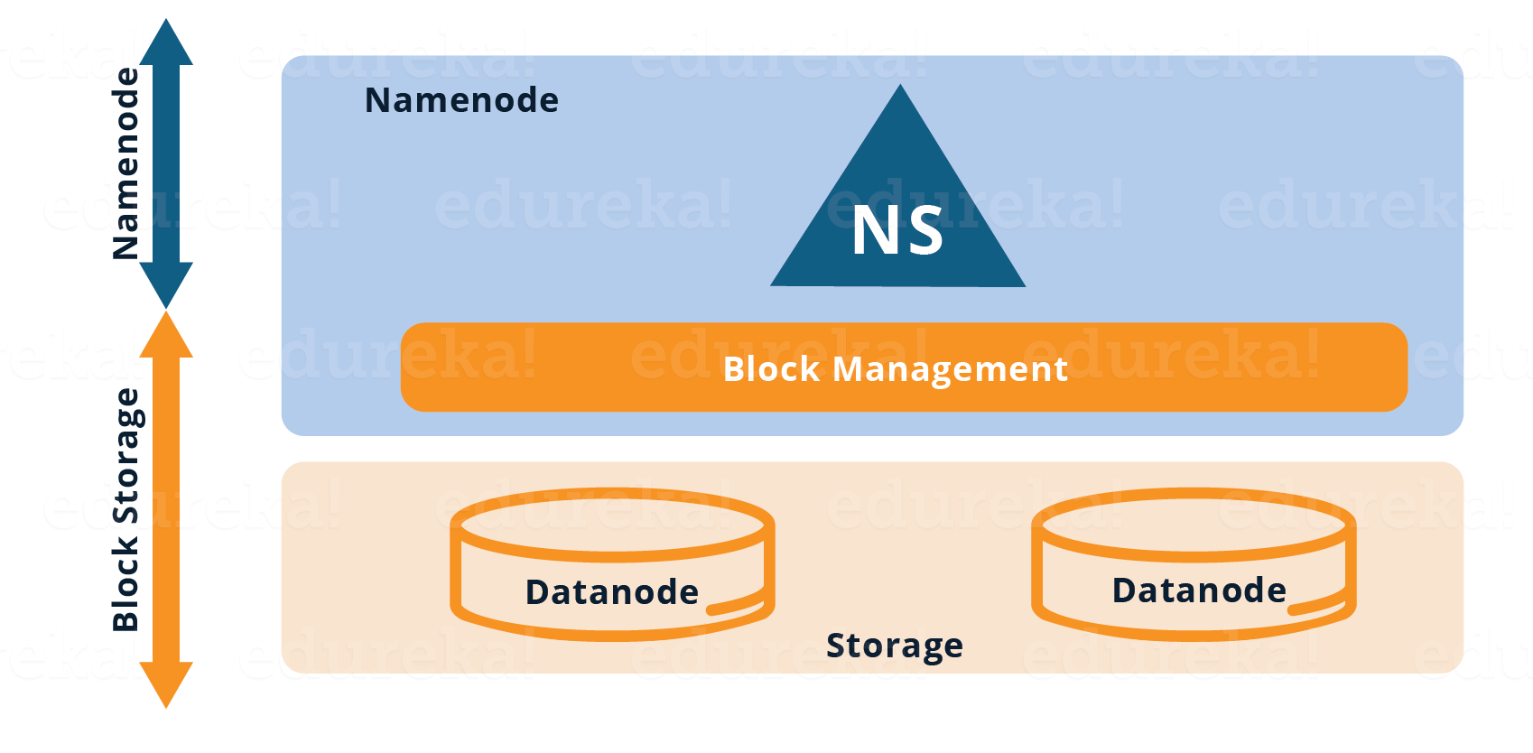
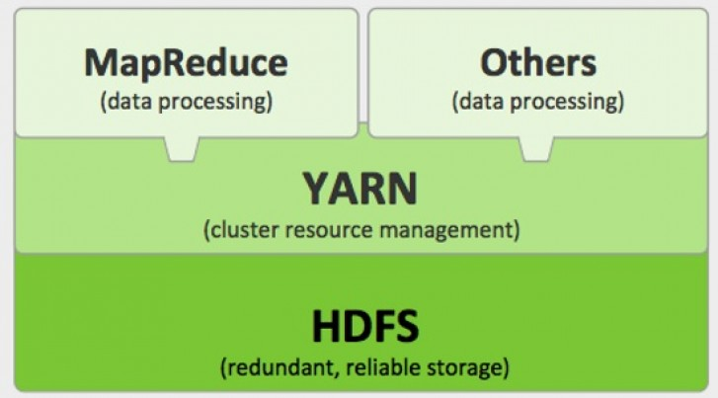
The Cluster
Three machines:
hadoop-ns-dev.humboldt.edu (8GB RAM, 8 Cores, 40GB Storage)
hadoop-dn1-dev.humboldt.edu (8GB RAM, 8 Cores, 40GB Storage)
hadoop-dn2-dev.humboldt.edu (8GB RAM, 8 Cores, 40GB Storage)
https://www.edureka.co/blog/overview-of-hadoop-2-0-cluster-architecture-federation/

Slide 4
Technologies Evaluated
Hive
Hive allows users to use SQL like queries on data stored in HDFS and has been around the longest.
HIVE works by converting HiveQL (HQL) into MapReduce Jobs.
Hive on Tez
Tez simply replaces the conversion engine in Hive.
Instead of MapReduce Tez uses directed-acyclic-graph of tasks for processing data.
SparkSQL
SQL interpreter for Spark, a Fast and general engine for large-scale in memory data processing.
pySpark
Python API for manipulating Spark DataFrames.
Allows users more control over data than SQL.

Slide 5

Hive
Pros:
Very easy to pick up for those familiar with SQL.
Full SQL Toolset , Joins, CRUD operations.
Functions comparable to those offered by oracle.
Requires very little configuration / maintenance.
Cons:
Quite Slow.
Only offers basic support for indexes.

Slide 6

Hive on Tez
Pros:
Includes all features in HIVE.
Can run up to 3x faster than a normal Hive MapReduce job.
Can switch between standard Hive and Tez jobs with one line of code.
Cons:
Can be troublesome to configure.
Some jobs require different configurations to achieve optimal performance.
Tez CBO (cost based optimizer) can cause problems, yet sometimes provides a slight speedup.
Not as reliable as standard Hive.

Slide 7

SparkSQL
Pros:
Supports most SQL features, such as Select, Where, join, Group By.
Very fast due to in memory transformations.
Built in Query optimizer that choses fastest execution solution.
If query requires more memory than available, it will “spill over” and use disk space to complete query.
Cons:
Does not support Update or Delete. (By Design)
This due to the fact that the underlying data structure is an immutable Spark DataFrame.
Requires a substantial amount of memory.
Requires more code to achieve translations (due to no Update support)

Slide 8

pySpark
Pros:
Removes a layer of overhead in Spark.- Spark does not have to do code generation for the SQL-Like input.
More powerful than SQL, access to full programming language.
Directly manipulates the Java objects through Py4J.
Can be slightly faster than SparkSQL. (limited dataset for comparison)
Cons:
Does not support update / delete.
Work / thought required to translate from existing PLSQL job to pySpark can be difficult.
If low-level transformation and actions and control are needed, query will not be optimized.
https://databricks.com/blog/2016/07/14/a-tale-of-three-apache-spark-apis-rdds-dataframes-and-datasets.html

Slide 9
ETL Technologies
Technology | SQL Like querying | In memory execution | Difficulty of installation | Difficulty of translation
Hive | Yes | No | Low | Low
Hive on Tez | Yes | No | Medium | Low
SparkSQL | Yes | Yes | Low | Medium
pySpark | No | Yes | Low | High

Slide 10
Execution Time Comparison This table shows the execution times for table creation. These tables are a part of the nightly job, and were selected to represent how the ETL process will run across the tested technologies.
Table Name | Oracle | HIVE on MR | Hive on Tez | SparkSQL
STG_HCM_MAXEFFDT_XLAT | 0.4 | 49.493 | 19.81 | 1.661
STG_HCM_PRE_COMP | 20 | 315.418 | 318.88 | 24.8
STG_HCM_PRE_PER_ORG | 0.3 | 25.766 | 11.34 | 0.779
STG_HCM_MAXEFFDT_ACTION | 0.2 | 42.204 | 11.72 | 0.435
STG_HCM_MAXEFFDT_ACTRSN | 0.2 | 41.102 | 11.92 | 0.836
STG_HCM_MAXEFFDT_POSITION | 0.3 | 43.512 | 4.4 | 0.784
STG_HCM_FACT_JOB | 60.3 | 508.869 | 2500 | 50.213
STG_HCM_DIM_JOB | 45 | 206.211 | 97.638 | 25.679
STG_HCM_DIM_POSITION | 0.5 | 59.903 | 22.167 | 3.837
DIM_HCM_POSITION | 0.3 | 15.354 | 5.445 | 3.482
Total: | 127.5 | 1307.832 | 3003.32 | 112.506
Minutes: | 2.1 | 21.8 | 50.1 | 1.9

Slide 11
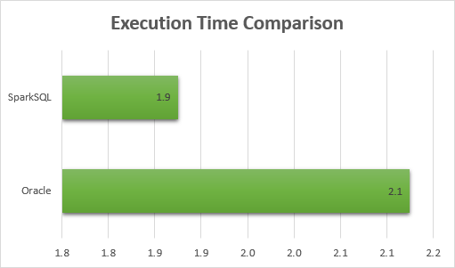
Execution Time Comparison

Slide 12
Lines of Code This table is meant to provide a rough estimate on how much work is required to convert from PLSQL to each Technology.
Table Name | Oracle | Hive | Hive on Tez | SparkSQL | pySpark
STG_HCM_MAXEFFDT_XLAT | 34 | 49 | 50 | 51 | 47
STG_HCM_PRE_COMP | 201 | 167 | 168 | 164 | --
STG_HCM_PRE_PER_ORG | 58 | 45 | 46 | 45 | --
STG_HCM_MAXEFFDT_ACTION | 58 | 48 | 49 | 48 | --
STG_HCM_MAXEFFDT_ACTRSN | 62 | 48 | 49 | 50 | --
STG_HCM_MAXEFFDT_POSITION | 187 | 132 | 133 | 134 | --
STG_HCM_FACT_JOB | 484 | 324 | 325 | 497 | --
STG_HCM_DIM_JOB | 396 | 258 | 259 | 262 | --
STG_HCM_DIM_POSITION | 145 | 100 | 101 | 98 | --
DIM_HCM_POSITION | 32 | 29 | 30 | 29 | --
Total | 1657 | 1200 | 1210 | 1378 | --
Average | 166 | 147 | 120 | 138 | --

Slide 13
Time Spent / Difficulty
Technology | Time Spent
Hive | 9-10 Days
Hive on Tez | 4 Days
SparkSQL | 4 Days
pySpark | 8 Days

Slide 15
Recommendations
If the data warehouse were to go with a Hadoop based warehousing solution:
Being that the two main concerns would be speed and ease of use I would recommend: SparkSQL
Why?
While SparkSQL is third on my list of difficulty, the boost in execution time compared to the relative difficulty increase is a fair trade-off.
SparkSQL was the only on the tested technologies to actually out preform our current solution.
At a larger scale with more nodes / RAM SparkSQL indicated potential for significant speed gain compared to Oracle.

Slide 16
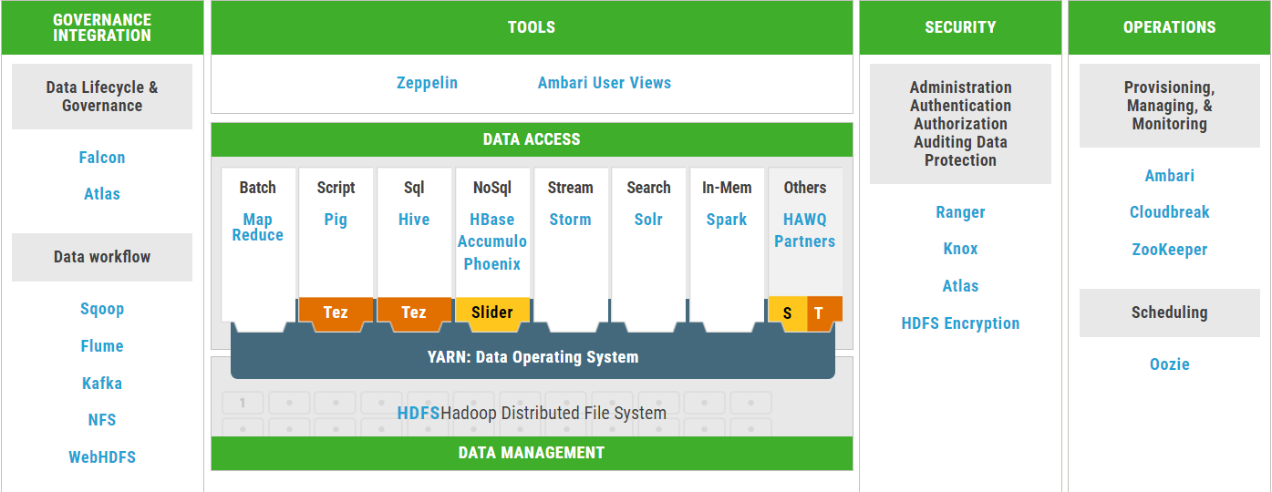
A note on vendors…

Slide 17
Questions

